Slide 1
Introduction to Python Programming
Database Connectivity
Ms. Shital H. Dinde

Slide 2
Need of Database
Data input and generated during execution of a program is stored in RAM.
If it is to be stored persistently, it needs to be stored in database tables.
There are various relational database management systems (RDBMS) available.
MySQL
PostgreSQL
Microsoft SQL Server
Oracle
SQLite
and many more...

Slide 3
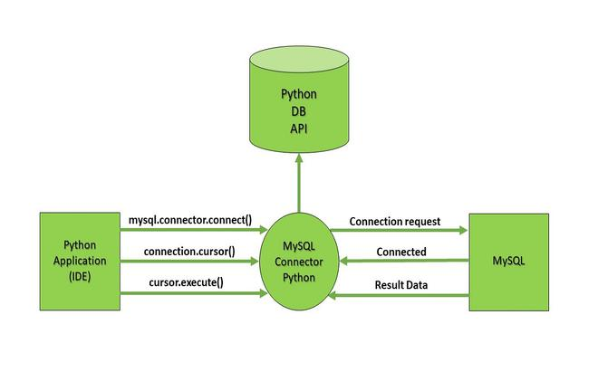
Database
Relational databases use SQL (Structured Query Language) for performing INSERT/DELETE/UPDATE operations on the database tables.

Slide 4
Install module
To create a connection between the MySQL database and Python, the connect() method of mysql.connector module is used.
Download get-pip.py script from following URL −
https://bootstrap.pypa.io/get-pip.py
python get-pip.py
Install mysql.connector
pip install mysql-connector-python
pip install cx_Oracle

Slide 5
Create Connection
Username- It is simply the username you give to work MySQL server with, the Default username is root.
Password- Password is given by the user when you have installed the MySQL database. I am giving password here as ‘password123’
Host Name- This basically is the server name or IP address on which your MySQL is running, If it is a ‘localhost’, then your IP address is 127.0.0.0
mysql.connector.connect(
host = "localhost",
user = "yourusername",
password = "your_password"
)

Slide 6
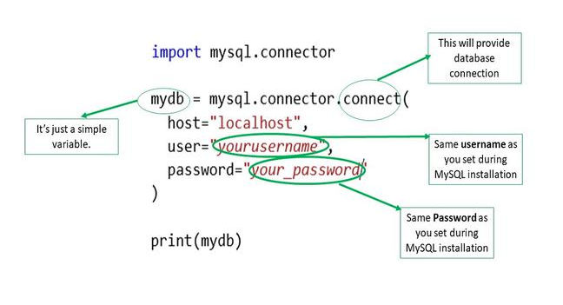
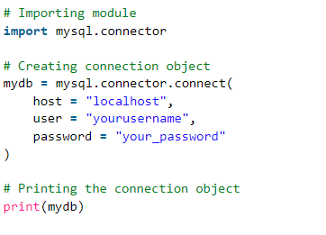

Create Connection

Slide 7
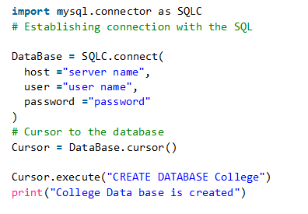
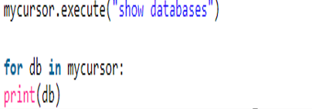
Creating a Database
To create a database, we will use CREATE DATABASE database_name statement and we will execute this statement by creating an instance of the ‘cursor’ class.

Slide 8
Database Operations[CRUD]
Create– It is an SQL statement used to create a record in the table or can say it is used for creating a table.
Read- It is used for fetching useful information from the database.
Update- This particular SQL statement is used for updating the records in the table or updating the table.
Delete- As the name itself justifies this command is used for deleting the table.

Slide 9
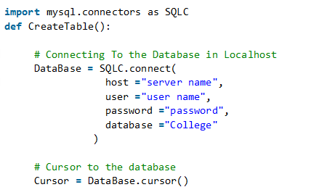

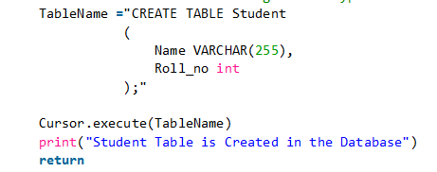
Create– It is an SQL statement
used to create a record in the table or
can say it is used for creating a table.

Slide 10
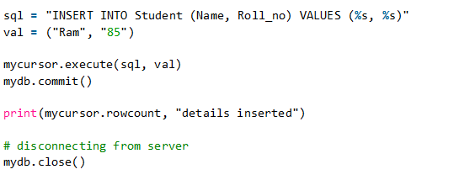
Inserting data

Slide 11
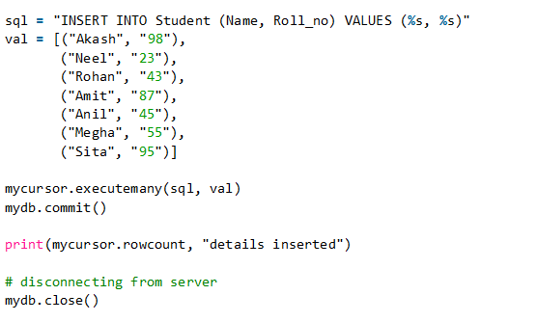
Inserting data

Slide 12
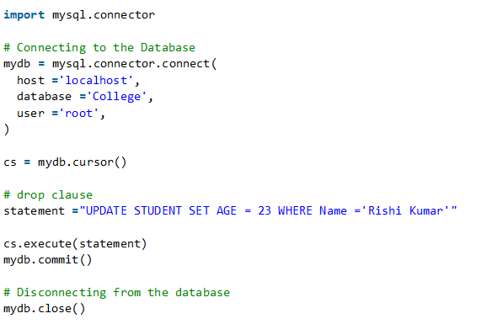
Updating data

Slide 13
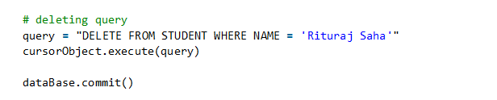
Delete data

Slide 14
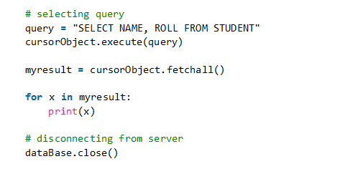
Read data

Slide 15
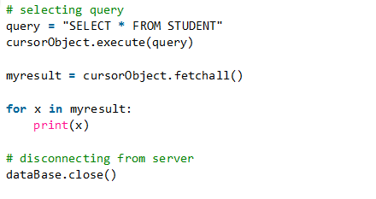
Read data

Slide 16
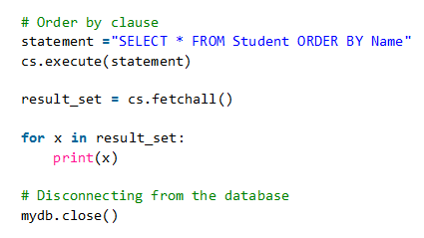
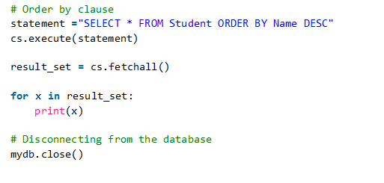
Read data

Slide 17
